Slide 1
Student Business Services studentbusiness.fsu.edu

Slide 2
What does SBS do?
Collect on behalf of the University
Assess Tuition and Fees
Process Financial Aid and Refunds
Process Florida Prepaid and
Third-Party Billings
Provide yearly tax information /
Form 1098-T

Slide 3
What might I be charged at FSU?
Tuition and Fees
Clinic Visits
Late Fees
Health Insurance
Meal Plans
International Programs
Parking Citations
Bookstore
Lost / Damaged Materials
Library Fines
Transcripts
Housing / Rent

Slide 4
Tuition Assessment / Rates
Current In-State Undergraduate Rate
$215.55 Per credit
Current Out-of-State Undergraduate Rate
$721.10 Per credit
Tuition is typically assessed one month out from the
start of term
Tuition is due by the end of the second week of the term
Tuition is assessed per credit hour, not per course

Slide 5
Invoicing
FSU does not mail paper invoices until you
separate from the University
Students receive an email each Monday
morning to their campus email address notifying
them of a balance
Online account statements are available 24/7 on
MyFSU
We recommend that you check your account
once per week

Slide 6
Consequences of Paying Late
Tuition:
$100 Late Payment Fee
Cancellation of class schedule
Parking / Housing:
Late Fees
Balance > $500
Holds on registration, transcripts, and diplomas
Balance < $500
Holds on transcripts and diplomas

Slide 7
Payment Options
Financial Aid
Disbursements occur prior to the start of
term, at the start of term, and each Tuesday
and Thursday following
Online
Credit Card & eCheck
2.3% service fee added to all credit card
transactions
In Person
Monday – Friday 8:30am – 4:30pm
Cash, Check, Money Order, Cashier’s Check,
FSUCard
By Mail
Check or money order payable to FSU

Slide 8
Alternative Payment Methods
Florida Prepaid
No proof of prepaid necessary
Review your benefits letter for plan type
If plan purchased prior to 2007, differential fee waived
Billing applied before aid (like Bright Futures) pays
529 / Investment / Savings Plans
Contact your plan provider for exact instructions
Typically, plans require an invoice from the institution
before funds are released
VA Benefits
Work with FSU’s Veteran’s Affairs office to
certify your schedule and benefits
SBS will process your payment and coordinate any
payment issues

Slide 9
What do you need to do?
Check / familiarize yourself with MyFSU
Check your email
Provide us with a refund bank account
Complete “Title IV” authorization to allow federal
aid to pay your charges
Delegate a user to speak to us on your behalf
Check your address and telephone information
annually in case we need to reach you

Slide 10
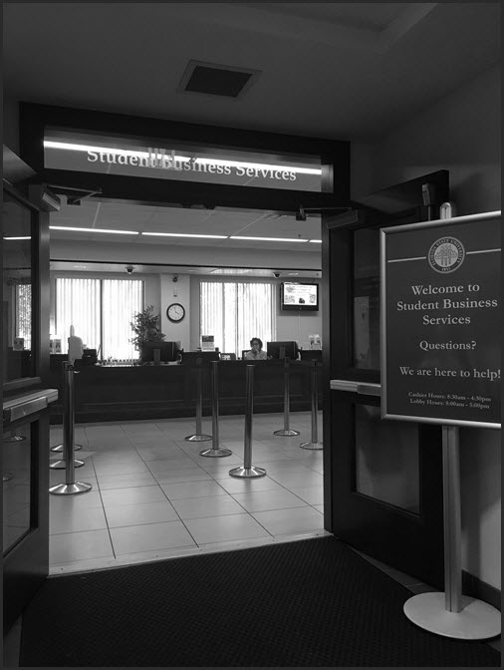
Our Contact Information
Mailing Address: Student Business Services
1500 University Center A
Tallahassee, FL 32306-2394
Web: studentbusiness.fsu.edu
Telephone: (850)644-9452
Fax: (850)644-5142
Email: studentbusiness@fsu.edu

